Slide 1
Notes:
SLIDE #0 - Blank Background

Slide 2
Notes:
SLIDE #1 - Title: “Would I Work For Me?

Slide 3
The number one reason people thrive at work is their boss. It’s also the number one reason they quit.
- Gallup Organization Study
Notes:
SLIDE #2 – “The number one reason people thrive at work is their boss. It’s also the number one reason they quit.” - Gallup Organization Study

Slide 4
What makes you work for someone?
+ -
_____________________ _____________________
_____________________ _____________________ _____________________ _____________________
_____________________ _____________________
_____________________ _____________________
_____________________ _____________________ _____________________ _____________________
_____________________ _____________________
Traits:
Effect on you and/or
your work:
Notes:
SLIDE #3 – What Makes You Work For Someone?

Slide 5
Four Wrong Ideas
Notes:
SLIDE #4A – Four Wrong Ideas

Slide 6
Four Wrong Ideas
1. I’M IN CHARGE HERE
Notes:
SLIDE #4B – Four Wrong Ideas: 1. I’M IN CHARGE HERE

Slide 7
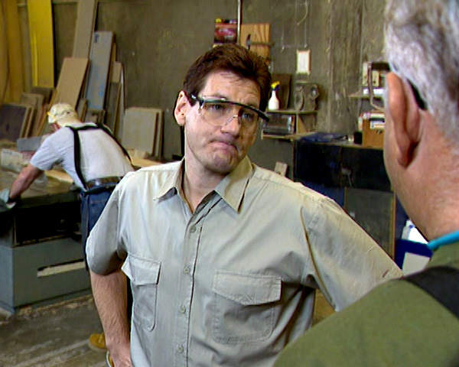
Four Wrong Ideas
1. I’M IN CHARGE HERE
2. DON’T BE A PUSHOVER
Notes:
SLIDE #4C – Four Wrong Ideas: 2. DON’T BE A PUSHOVER

Slide 8
Four Wrong Ideas
1. I’M IN CHARGE HERE
2. DON’T BE A PUSHOVER
3. TELL PEOPLE WHAT THEY’RE DOING WRONG
Notes:
SLIDE #4D – Four Wrong Ideas: 3. TELL PEOPLE WHAT THEY’RE DOING WRONG

Slide 9
Four Wrong Ideas
1. I’M IN CHARGE HERE
2. DON’T BE A PUSHOVER
3. TELL PEOPLE WHAT THEY’RE DOING WRONG
4. MAKE A PUBLIC
EXAMPLE OF MISTAKES
Notes:
SLIDE #4E – Four Wrong Ideas: 4. MAKE A PUBLIC EXAMPLE OF MISTAKES

Slide 10
Eight Effective Management Practices
Notes:
SLIDE #5A – Eight Effective Management Practices:

Slide 11
Eight Effective Management Practices
1. SHARE INFORMATION
Notes:
SLIDE #5B – Eight Effective Management Practices: 1. SHARE INFORMATION

Slide 12
Eight Effective Management Practices
1. SHARE INFORMATION
2. GET PEOPLE INVOLVED
Notes:
SLIDE #5C – Eight Effective Management Practices: 2. GET PEOPLE INVOLVED

Slide 13
Eight Effective Management Practices
1. SHARE INFORMATION
2. GET PEOPLE INVOLVED
3. LISTEN TO PEOPLE’S CONCERNS
Notes:
SLIDE #5D – Eight Effective Management Practices: 3. LISTEN TO PEOPLE’S CONCERNS

Slide 14
Eight Effective Management Practices
1. SHARE INFORMATION
2. GET PEOPLE INVOLVED
3. LISTEN TO PEOPLE’S CONCERNS
4. TAKE ACTION TO SHOW THAT
YOU CARE
Notes:
SLIDE #5E – Eight Effective Management Practices: 4. TAKE ACTION TO SHOW THAT YOU CARE

Slide 15
Eight Effective Management Practices
1. SHARE INFORMATION
2. GET PEOPLE INVOLVED
3. LISTEN TO PEOPLE’S CONCERNS
4. TAKE ACTION TO SHOW THAT
YOU CARE
5. TELL PEOPLE WHAT THEY’RE DOING RIGHT
Notes:
SLIDE #5F – Eight Effective Management Practices: 5. TELL PEOPLE WHAT THEY’RE DOING RIGHT

Slide 16
Eight Effective Management Practices
1. SHARE INFORMATION
2. GET PEOPLE INVOLVED
3. LISTEN TO PEOPLE’S CONCERNS
4. TAKE ACTION TO SHOW THAT
YOU CARE
5. TELL PEOPLE WHAT THEY’RE DOING RIGHT
6. FOCUS ON SOLUTIONS, NOT PROBLEMS
Notes:
SLIDE #5G – Eight Effective Management Practices: 6. FOCUS ON SOLUTIONS, NOT PROBLEMS

Slide 17
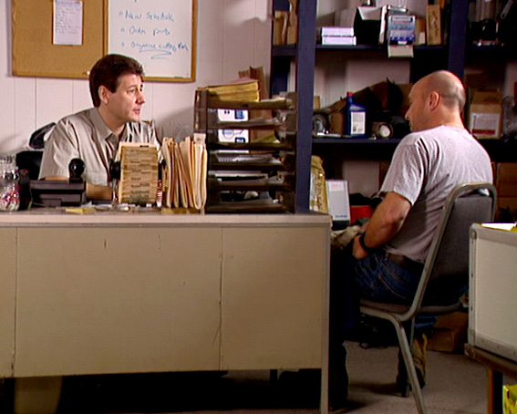
Eight Effective Management Practices
1. SHARE INFORMATION
2. GET PEOPLE INVOLVED
3. LISTEN TO PEOPLE’S CONCERNS
4. TAKE ACTION TO SHOW THAT
YOU CARE
5. TELL PEOPLE WHAT THEY’RE DOING RIGHT
6. FOCUS ON SOLUTIONS, NOT PROBLEMS
7. DEAL WITH MISTAKES IN PRIVATE
Notes:
SLIDE #5H – Eight Effective Management Practices: 7. DEAL WITH MISTAKES IN PRIVATE

Slide 18
Eight Effective Management Practices
1. SHARE INFORMATION
2. GET PEOPLE INVOLVED
3. LISTEN TO PEOPLE’S CONCERNS
4. TAKE ACTION TO SHOW THAT
YOU CARE
5. TELL PEOPLE WHAT THEY’RE DOING RIGHT
6. FOCUS ON SOLUTIONS, NOT PROBLEMS
7. DEAL WITH MISTAKES IN PRIVATE 8. USE MISTAKES TO HELP PEOPLE
Notes:
SLIDE #5I – Eight Effective Management Practices: 8. USE MISTAKES TO HELP PEOPLE

Slide 19
Of all the workplace stressors, a bad boss is possibly the worst, directly impacting the productivity of employees.
- The Financial Express: “When Bad Bosses Happen to Good People”
Notes:
SLIDE #6A – “Of all the workplace stressors, a bad boss is possibly the worst, directly impacting the productivity of employees.” - The Financial Express: “When Bad Bosses Happen to Good People”

Slide 20
Of all the abuses, employees find public humiliation the most intolerable.
- The Financial Express: “When Bad Bosses Happen to Good People”
Notes:
SLIDE #6B – “Of all the abuses, employees find public humiliation the most intolerable.” - The Financial Express: “When Bad Bosses Happen to Good People”

Slide 21
Another high crime of bad managers
is showering criticism while stinting
on praise.
- National Public Radio
Notes:
SLIDE #6C – “Another high crime of bad managers is showering criticism while stinting on praise.” - National Public Radio

Slide 22
An employee’s happiness has less to
do with a chief executive and more to
do with his supervisor.
- Inc.com: “Bad Bosses Are Bad For Business”
Notes:
SLIDE #7A – “Of all the abuses, employees find public humiliation the most intolerable.” - The Financial Express: “When Bad Bosses Happen to Good People”

Slide 23
One of the biggest things you can do
for people is provide them with great
bosses.
- Inc.com: “Bad Bosses Are Bad For Business”
Notes:
SLIDE #7B – “One of the biggest things you can do for people is provide them with great bosses.” - Inc.com: “Bad Bosses Are Bad For Business”

Slide 24
Notes:
SLIDE #8 - Title: “Would I Work For Me?

Slide 25
Notes:
Blank Background

